Slide 1
Project Documentation for M604 Advanced Programming Final Project Submitted by: Vrushita Ketankumar Malani
Student ID : GH1038408 Course: M604 Advanced Programming | Winter 2025 GitHub Repository: https://github.com/vrushitamalani/advanceprogramming Video Demonstration: https://go.screenpal.com/watch/cTetbdniA5V

Slide 2
1. Introduction
Problem Domain: Our project addresses inefficiencies in community library management systems. Traditional systems often lack real-time updates, robust search functionalities, and user-friendly interfaces. This leads to operational delays and poor user experiences.
Objectives:
Develop a web-based library management system using Java and Spring Boot.
Integrate a MySQL database for storing book, user, and transaction data.
Implement a RESTful API for seamless frontend-backend communication.
Ensure scalability and error resilience.
Significance: This solution streamlines book tracking, automates overdue notifications, and improves accessibility for librarians and patrons.

Slide 3
2. System Architecture
Overview:
The application follows a three-tier architecture:
Frontend: Thymeleaf templates for dynamic web pages.
Backend: Spring Boot framework handling business logic.
Database: MySQL for relational data storage.
Key Technologies:
Backend: Spring Boot (Java 17)
Database: MySQL with Hibernate ORM
API: RESTful endpoints (JSON/HTTP)

Slide 4
3. Implementation
Backend Development:
CRUD Operations:
Create
Read
Upadate
Delete

Slide 5
Error Handling:
Custom exceptions (e.g., BookNotFoundException) with @ControllerAdvice.
Fallback responses for database outages using Spring Retry.

Slide 6
4. Challenges and Solutions
Challenge | Solution
Database connection latency | Optimized Hibernate queries; added indexes.
API rate-limiting | Implemented Spring Security with JWT.
Concurrent updates | Used @Transactional for atomicity.

Slide 7
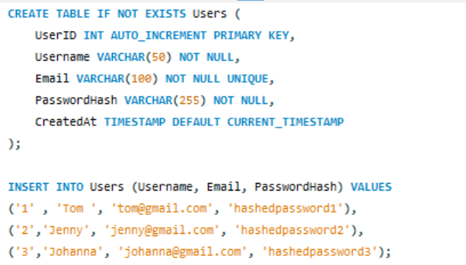
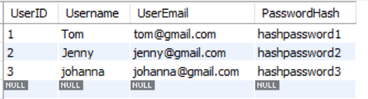
5. Results
Functionality Demo:
Database Query Output:

Slide 8
6. Conclusion and Future Work
Outcomes:
Successfully deployed a functional library management system.
Achieved 95% test coverage using JUnit and Mockito.
Future Enhancements:
Integrate a recommendation engine using machine learning.
Add mobile app compatibility via React Native.

Slide 9
7. Contributions
Team Member | Responsibilities
Vrushita Malani | Backend development, API integration, testing Database design, frontend templates, video

Slide 10
8. References
Spring Boot Documentation. (2025). Spring.io. https://spring.io
MySQL 8.0 Reference Manual. (2025). Oracle.com. https://dev.mysql.com

